Slide 1
Study’s goals/questions
Identify responsibility for seabird populations across the year
When and for which pops. are the High Seas most important?
Highlight important country-relationships
i.e. Which countries have highest exchange of (1) species, (2) individuals
Other potential goals
Assess risk/protection for threatened species across annual cycle

Slide 2
‘Bird days’
Basis of analysis
Number of ‘days’, per month, a bird(/track) spends in a given EEZ
Where ‘days’ are proportional to the number of EEZs visited in that day (e.g. If bird visits 2 EEZs, 0.5 bird days spent in each) (weights)
**Adjusted for number of tracking days with tracking data in that month So if a track is only 1 day long, it will only weigh 1/31 as much towards the population estimate of time spent compared to a track which is 31 days (31/31) long
Problem still exists that distribution of tracks in a month could be biased (e.g. all from first few days of a month)
Result: Proportion of (individual’s) time spent in EEZ(s) per month (ppt2)

Slide 3
‘Bird days’
* Individual means track (i.e. track_id)
Basis of analysis
Proportion of individual’s* time spent in EEZ(s) per month
Proportion of sample’s time spent in EEZ(s) per month
Adjust for relative contribution of each individual

Slide 4
‘Bird days’
Basis of analysis
Proportion of individual’s time spent in EEZ(s) per month
Adjust for relative contribution of each individual
Proportion of sample’s time spent in EEZ(s) per month
Option 1:
Assume representativeness
Option 2:
Test representativeness
Proportion of population’s time spent in EEZ(s) per month

Slide 5
Representativeness
Sample: how well do the tracked movements represent the wider (island group) population?
Instead of extent of area used, use number of EEZs visited
Set a threshold based on previous work (e.g. Gutowsky 2016’s 17-21 individuals)
N EEZs visited
N birds in sample

Slide 6
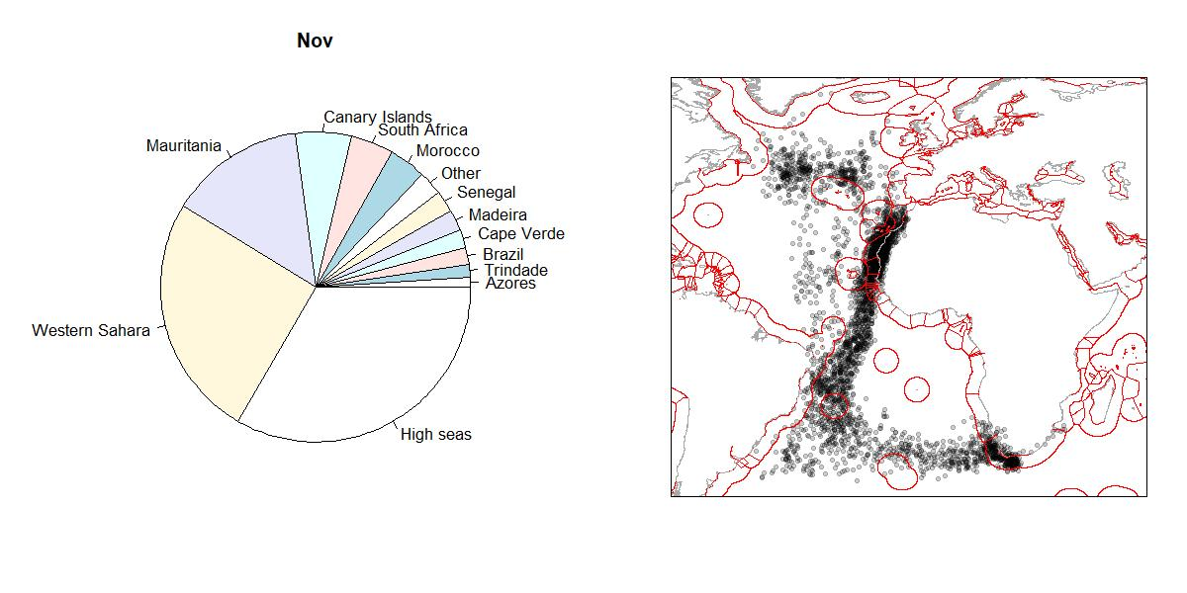
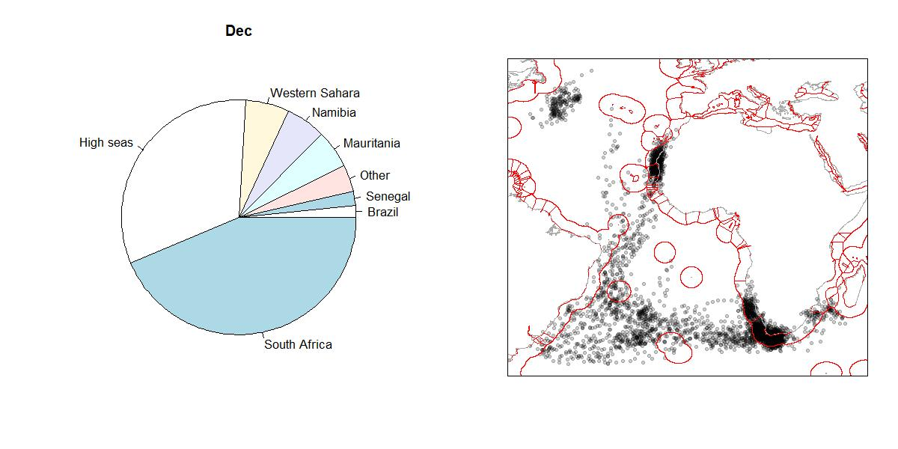
Analyze by island group population
Output (e.g. Cory’s Shearwaters from Madeira, Portugal)
composition of time spent per month
pp = Proportion of (sample’s/population’s) time spent in EEZ(s) per month

Slide 8
Extras

Slide 9
Analyze by species/population - where is the population over the year?
Number and % of birds from a population using EEZ(s) in a given month
# of birds = pp * site_pop_size
Where pp = Proportion of (sample’s) time spent in EEZ(s) per month

Slide 10
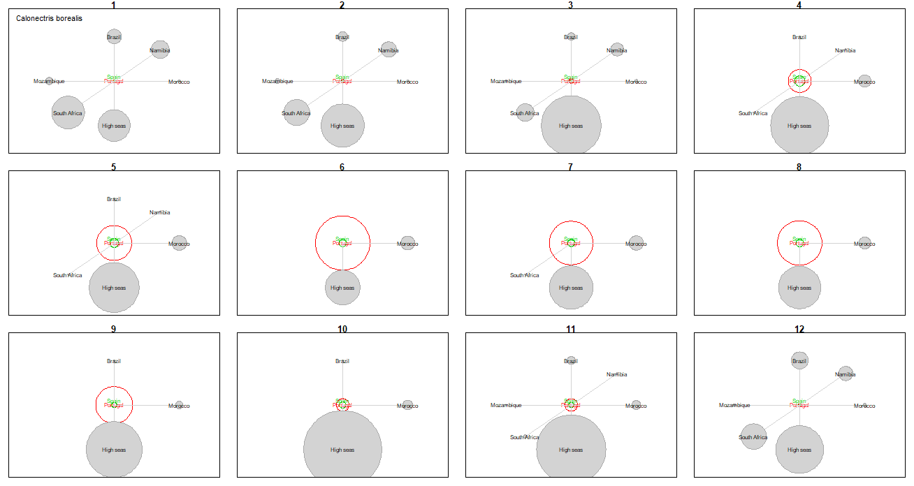
Analyze by species
Output (e.g. Cory’s Shearwaters from Spain, Portugal)

Slide 11
Analyze by species
Output (e.g. Cory’s Shearwaters from Spain, Portugal)
Shows the relative contribution of breeding sites to the global (*if all sites are tracked)
E.g. Portugal more important than Spain

Slide 12
Analyze by origin country – where is a country’s seabird community going?
Number of birds in an EEZ per month across the ‘community’ of a given country:
Adjusted for:
Tracked time per month
Relative population size (species-specific population estimate/# of species in community)
# of species in the community
Can be done on log-scale if one species is very abundant (e.g. great shearwater)

Slide 13
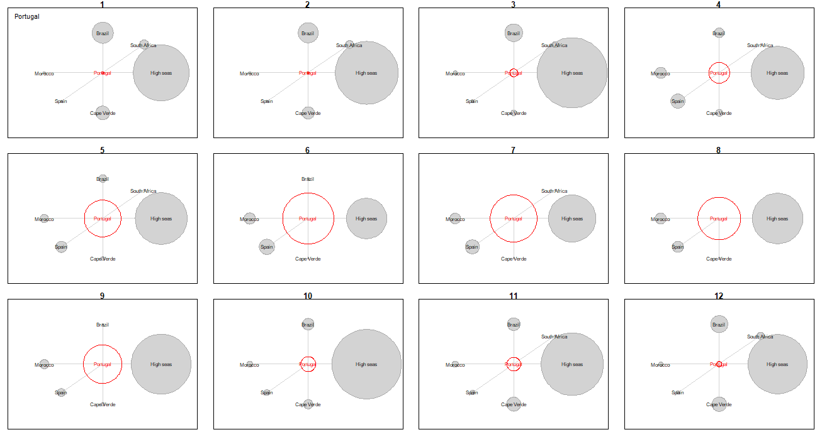
Analyze by origin country
Output (e.g. ?4 species from Portugal)

Slide 14
Analyze by origin country
Output (e.g. ?4 species from Portugal)
Only countries which host >5% of community population

Slide 15
Thoughts on strengths/limitations
Strengths:
Simple to calculate, and understand (and therefore to interpret)
Utilizes site-population estimates to say something about the number of birds moving to and fro
Weaknesses:
Under-utilizes higher-resolution data (e.g. PTT) which have more than 2 points a day
Assumes tracked sample is representative of the population/island group
Problems:
Current script attributes a bird-day based on a point representing half of the day (GLS), so the summed proportion of time spent in EEZs per month is above 1.

Slide 16
Representativeness
2 levels:
Sample: how well do the tracked movements represent the wider (island group) population?
Population: what is the contribution of each tracked island group to the global population?

Slide 17
Representativeness
Sample: how well do the tracked movements represent the wider (island group) population?
Instead of extent of area used, use number of EEZs visited
Set a threshold based on previous work (e.g. Gutowsky 2016’s 17-21 individuals)
N EEZs visited
N birds in sample

Slide 18
Representativeness
Population: what is the contribution of each tracked island group to the global population?
Set a threshold of ‘importance’?
Simple threshold (e.g. sum of island group contributions must be above e.g. 20% of global pop)
Using KBA thresholds (e.g. 0.5% for CR or EN spp., 1% for VU, equal or above 10% for NT or LC)
Include all with good tracking data: different actors may be in the specific stories of their ‘globally insignificant’ populations

Slide 19
Outputs
Island group-specific/species – specific ‘responsibility’ for ACAP

